Slide 1
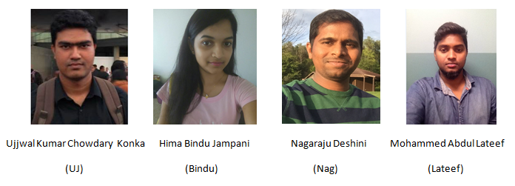
CPSC-8845-03: Team 3

Slide 2
Goal of the Project
Build an effective internet service company that can offer wide range of services to its customers and can compete with the existing companies.
Attract residential customers by giving them discounts for short to long term contracts.
Provide a reliable service to the client.
Design, develop and implement a consistent database to perform day to day customer transactions and manage them.
A database that can handle 100,000 customers and many more in future.

Slide 3
Important operations to perform
Create Indexes for fast query performance.
Create Integrity Constraints for establishing RDBMS.
Create Views for security purpose.
Create Triggers for auto updating.
Create enough datafiles at physical level which will have tablespaces, segments, extents and data blocks at logical level.
Take regular Backups. Store the backups in separate destination where your database is not stored.
Perform Database Recovery incase of failures. It is better to use RMAN for online recovery where your instance is still in up and running mode.
Create Partitions for better performance.
Create materialized views, surrogate keys, synonyms.

Slide 4
DB Switching
It is good way to maintain parallel a development database with respect to the production database just in case of “Fail Over” scenarios we can “Switch Over” Development DB into Production DB.

Slide 5
Blitzz Company Database Architecture
Indiana
Illinois
Wisconsin
Blitzz Company
Customer Database
Services Database
Employee Database
Customer
State
Company
Employee
Emp_address
Payment
Package
VOIP
Internet
TV

Slide 6
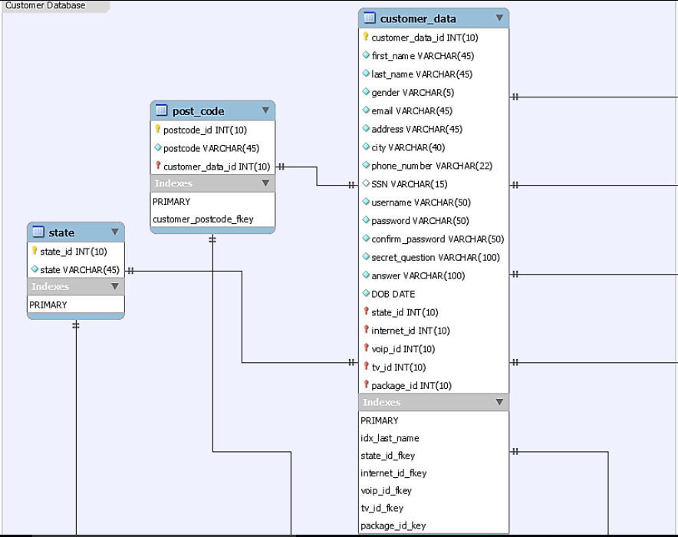
ER Model of Customer Database

Slide 7
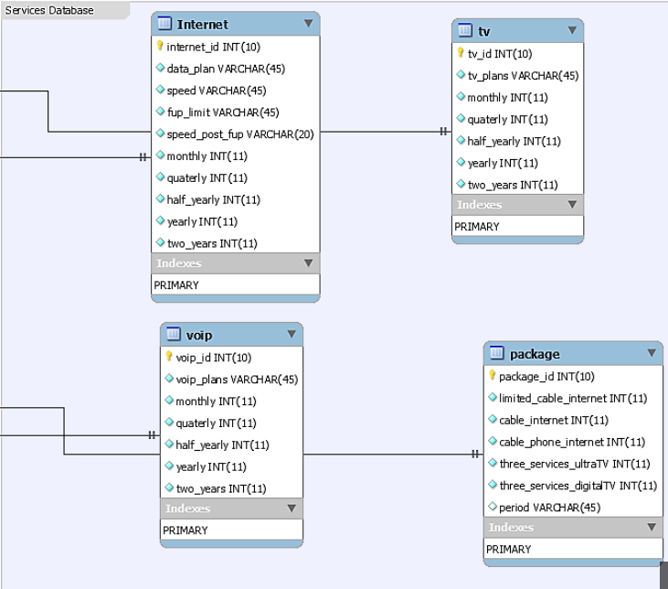
ER Model of Service Database

Slide 8
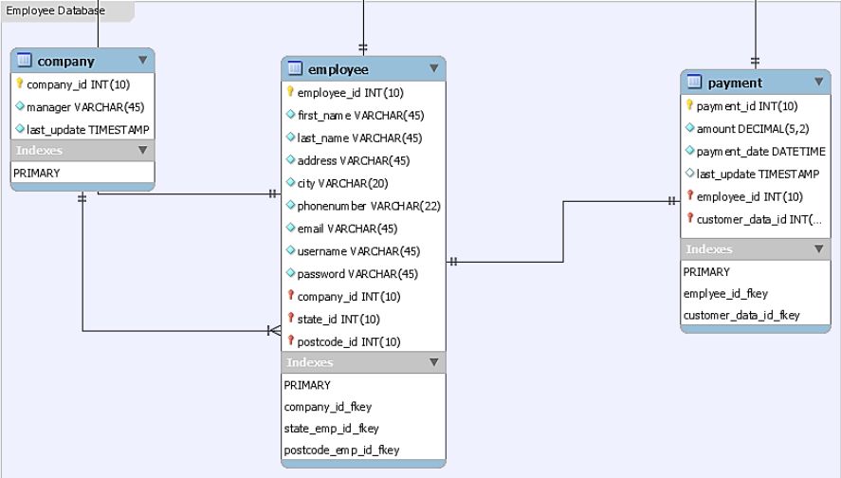
ER Model of Employee Database

Slide 9
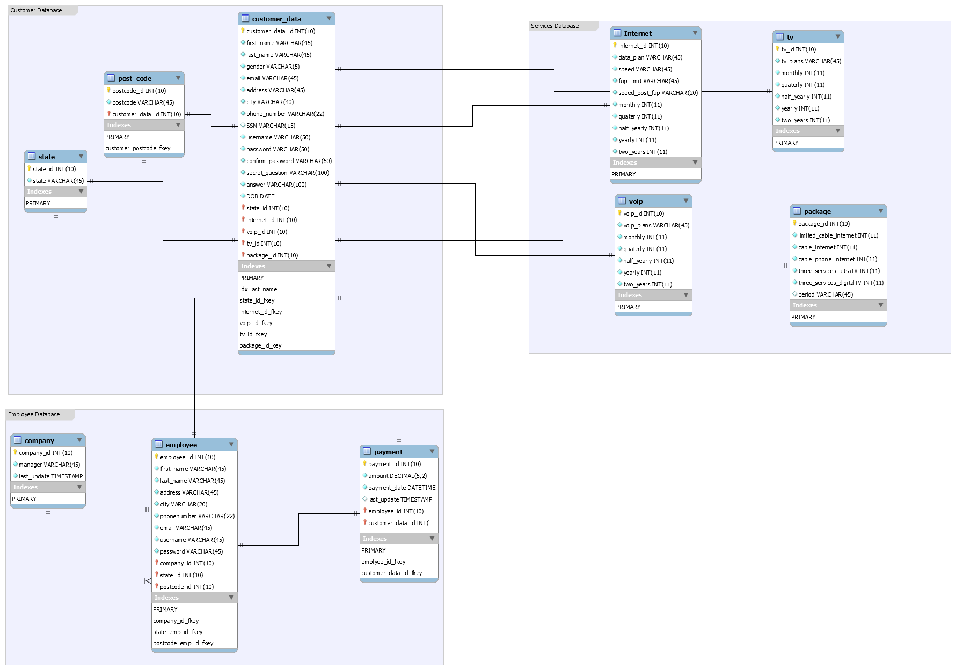
EER Model of the Project

Slide 10
Feature Requirements
We have gathered 144 requirements.
General Database Requirements
Customer Database Requirements.
Service Database Requirements.
Employee Database Requirements

Slide 11
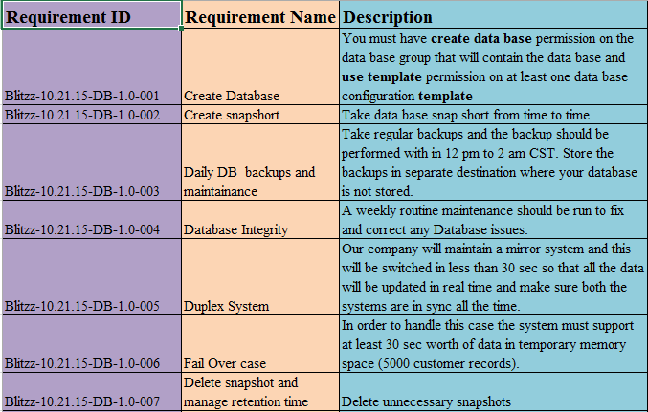
General Database requirements

Slide 12
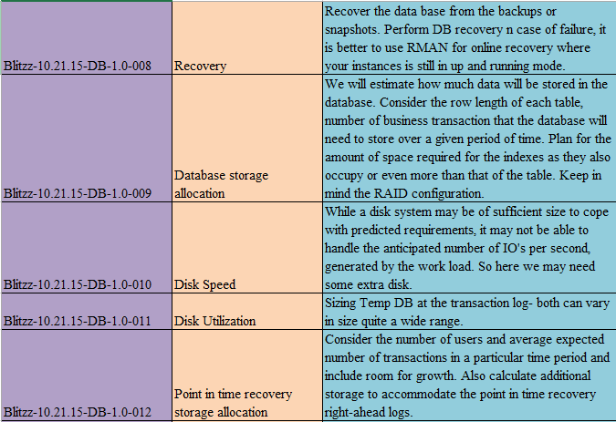

Slide 13
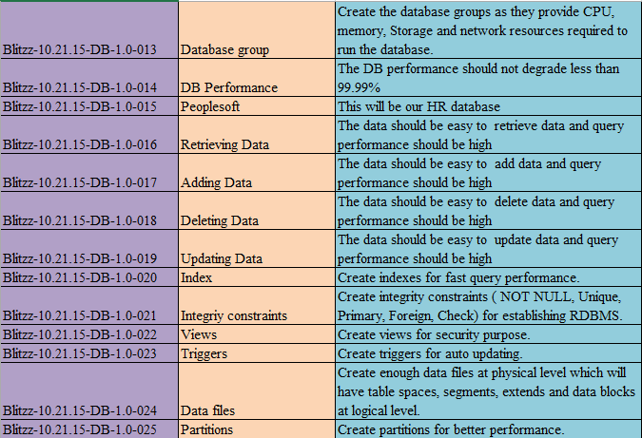

Slide 14
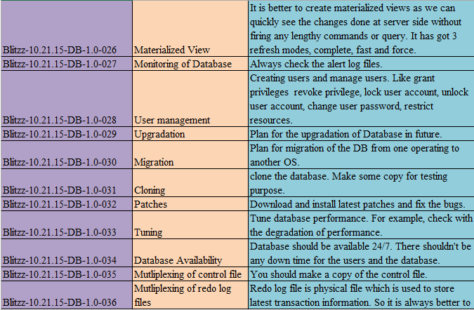

Slide 15
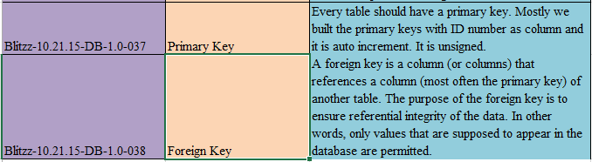

Slide 16
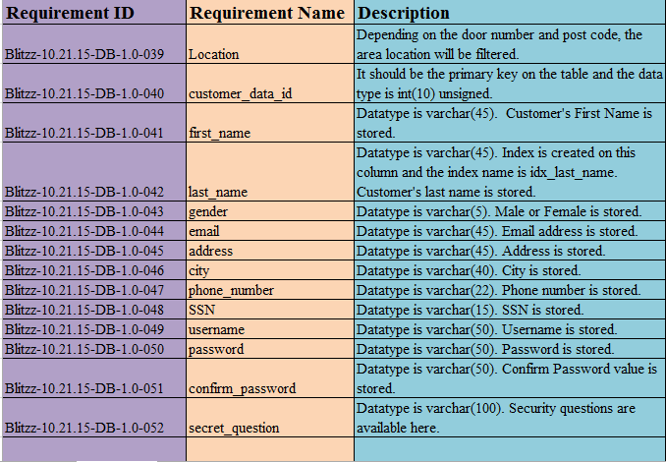
Customer Database requirements

Slide 17
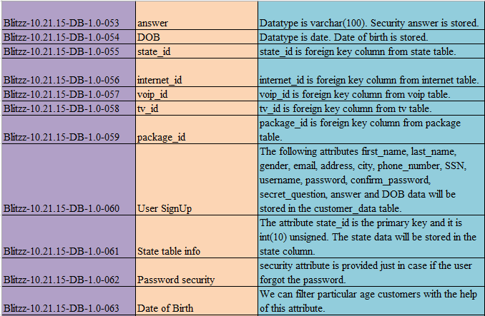

Slide 18
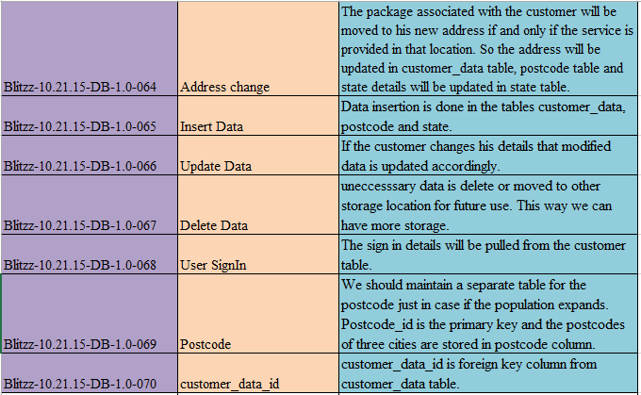

Slide 19
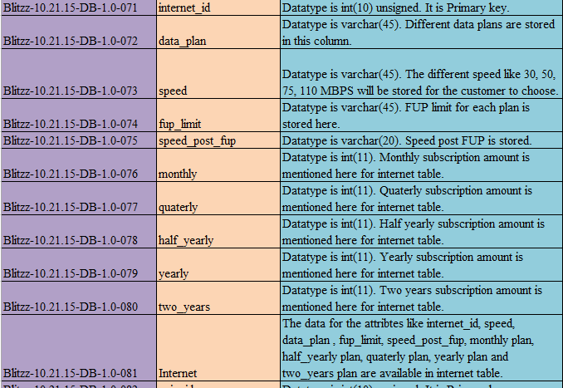
Service Database requirements

Slide 20
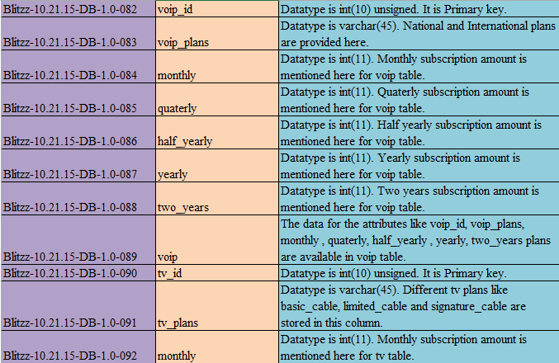

Slide 21
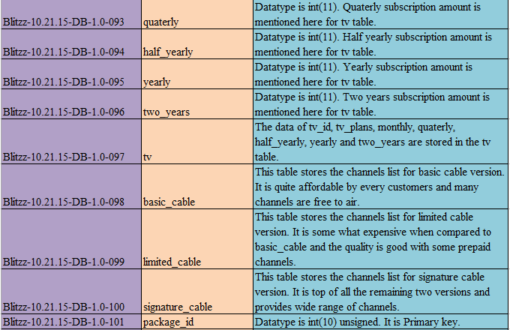

Slide 22
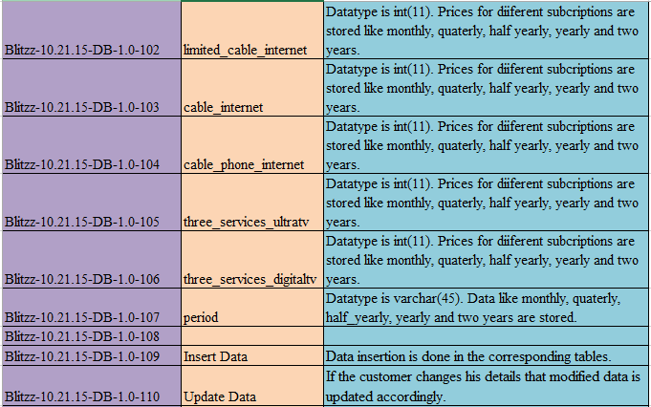

Slide 23
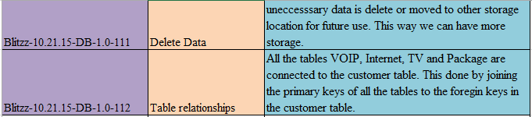

Slide 24
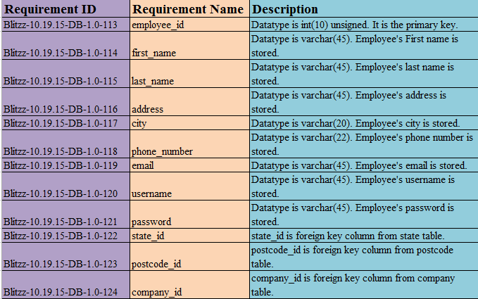
Employee Database Requirements

Slide 25
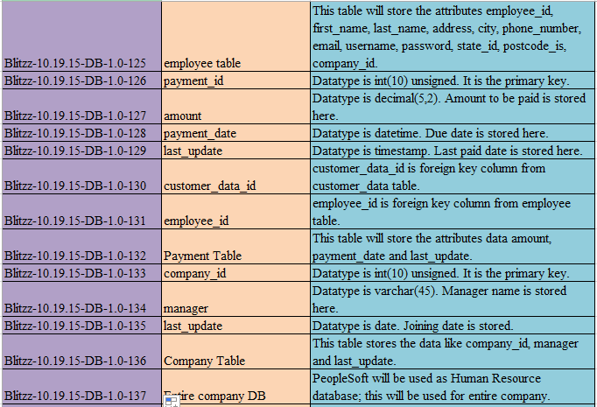

Slide 26
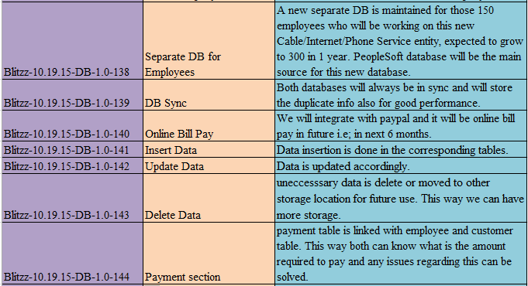

Slide 27


Slide 28


